Slide 1
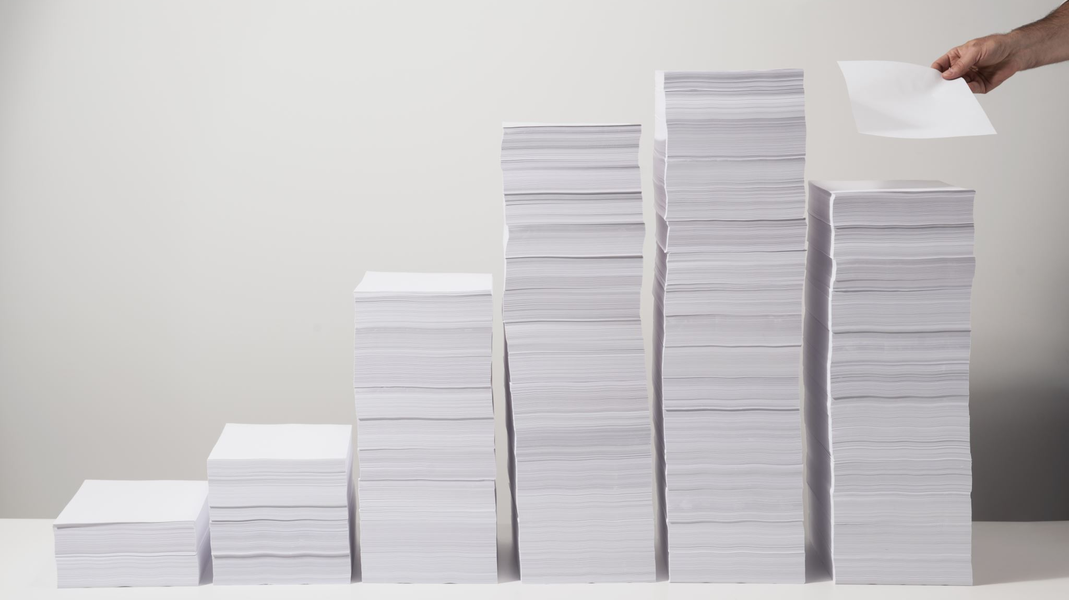
Traditional Paper Recycling Initiative at the University of Northampton
Group: Xavier-X
Members:
Jannat Awan
Athena Emma Xavier
Abid Zulfiqar
Muhammad Abdullah
Nimra Bibi
Ofego Aboh

Slide 2

contents
Introduction
Project Justification
Project Plan
Investment Appraisal
Sustainability and Innovation
Benefit and Dis-benefit
Risk Management Strategy
Quality Management Strategy
Communication Management Strategy
Conclusion

Slide 3
Introduction
Paper Recycling Revolution: A Sustainable Initiative for Our University
Waterside Campus Budget: £250,000
Timeline: June to December 2024
Objective: Implementing an Efficient Paper Recycling Project
Capacity: Designed to Process Paper Waste from University and Community Alignment with Changemaker
Principle: Integrating Social Innovation and Sustainability
Quality Standards and Design Requirements:
Compliance with Environmental Regulations and Safety Standards
Integration of Innovative Recycling Technologies
Modular Structure for Scalability and Adaptation
Value for Money: Resource Optimization for Cost-Effectiveness
Sustainability: Promoting Eco-Friendly Practices for Resource Conservation

Slide 4
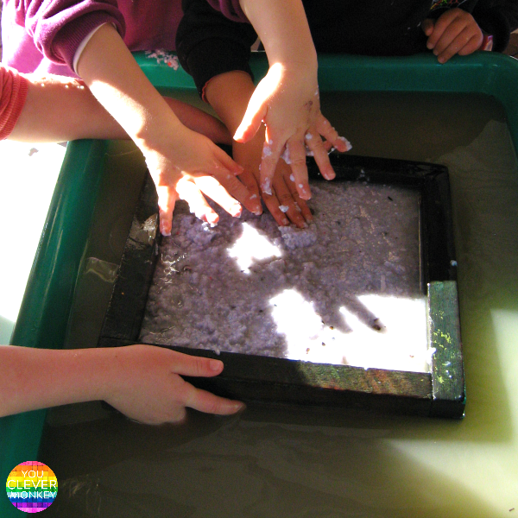
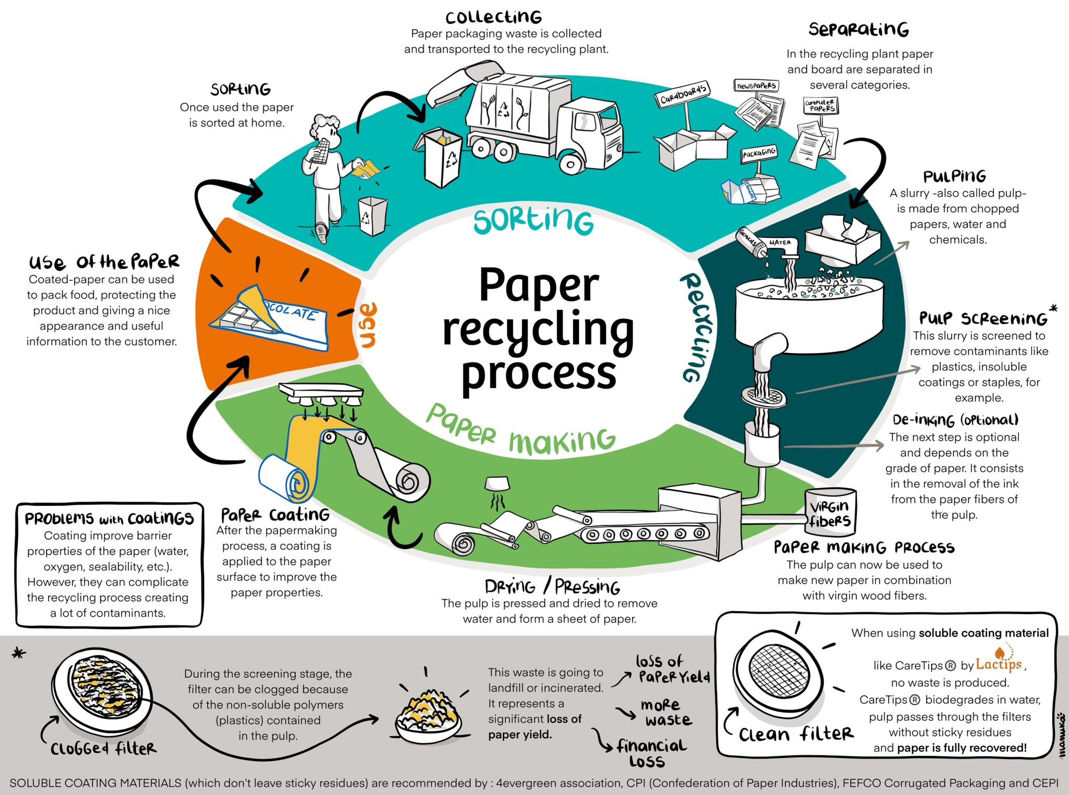
Paper recycling
Traditional method
Using technology

Slide 5

Project Justification
Challenge: Growing paper waste burdens landfills and strains the environment. Universities are major contributors.
Solution: Establish a small-scale paper recycling plant on campus.
Impact:
Reduce paper waste and environmental footprint.
Utilize traditional, sustainable paper recycling methods.
Create innovative, beautiful paper products for writing and artistic endeavors.
Outcome: A university community embracing sustainability and unleashing creativity through paper.
Option 1: Paper recycling using traditional method
Option 2: Paper recycling using Technology
Financial Cost
Option1: Cost £2.4 MM Payback 4.02 years ARR of 19.18%
Option 2: Cost £2.6 MM Payback 3.12 years ARR of 20.39%

Slide 6
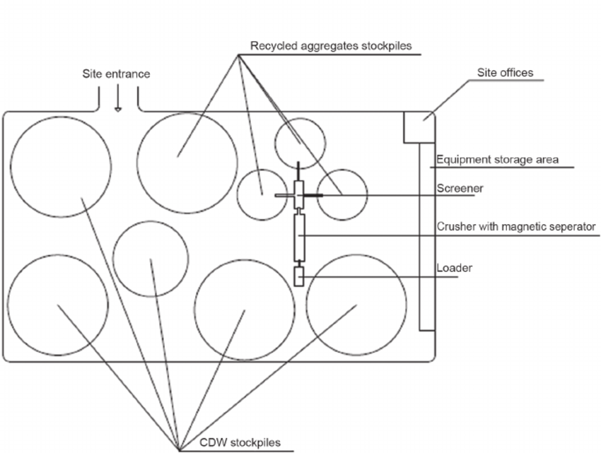
Layout

Slide 7
Project Plan
June 2024
July 2024
August 2024
September 2024
October 2024
November 2024
December 2024
Initiating: business case & PID
Planning: Construction Phase, Training Program Development, Equipment & Supplies Procurement
Executing: Schedule Refinement, Communication Plan Development, Risk, Quality
Close out: Support Activities, Project Evaluation, Project Handover
Monitoring and control
Monitoring and control in project management involves overseeing progress, updating documentation, authorizing reviews, assessing stage status, reporting highlights, addressing issues and risks, and taking corrective action as needed for successful project delivery.

Slide 8

Sustainability and Innovation in Paper Recycling
Sustainability:
People: Fostering awareness and engagement among individuals and communities to promote sustainable practices in paper recycling.
Planet: Implementing eco-friendly processes and technologies to minimize environmental impact and preserve natural resources.
Profit: Maximizing economic efficiency and value creation while ensuring the long-term viability and sustainability of paper recycling initiatives.
Innovation:
Encourages creative solutions and novel approaches in paper recycling.
Embraces new ideas, methodologies, and technologies to improve recycling processes.
Drives continuous improvement and adaptation to evolving industry standards and environmental challenges.

Slide 9
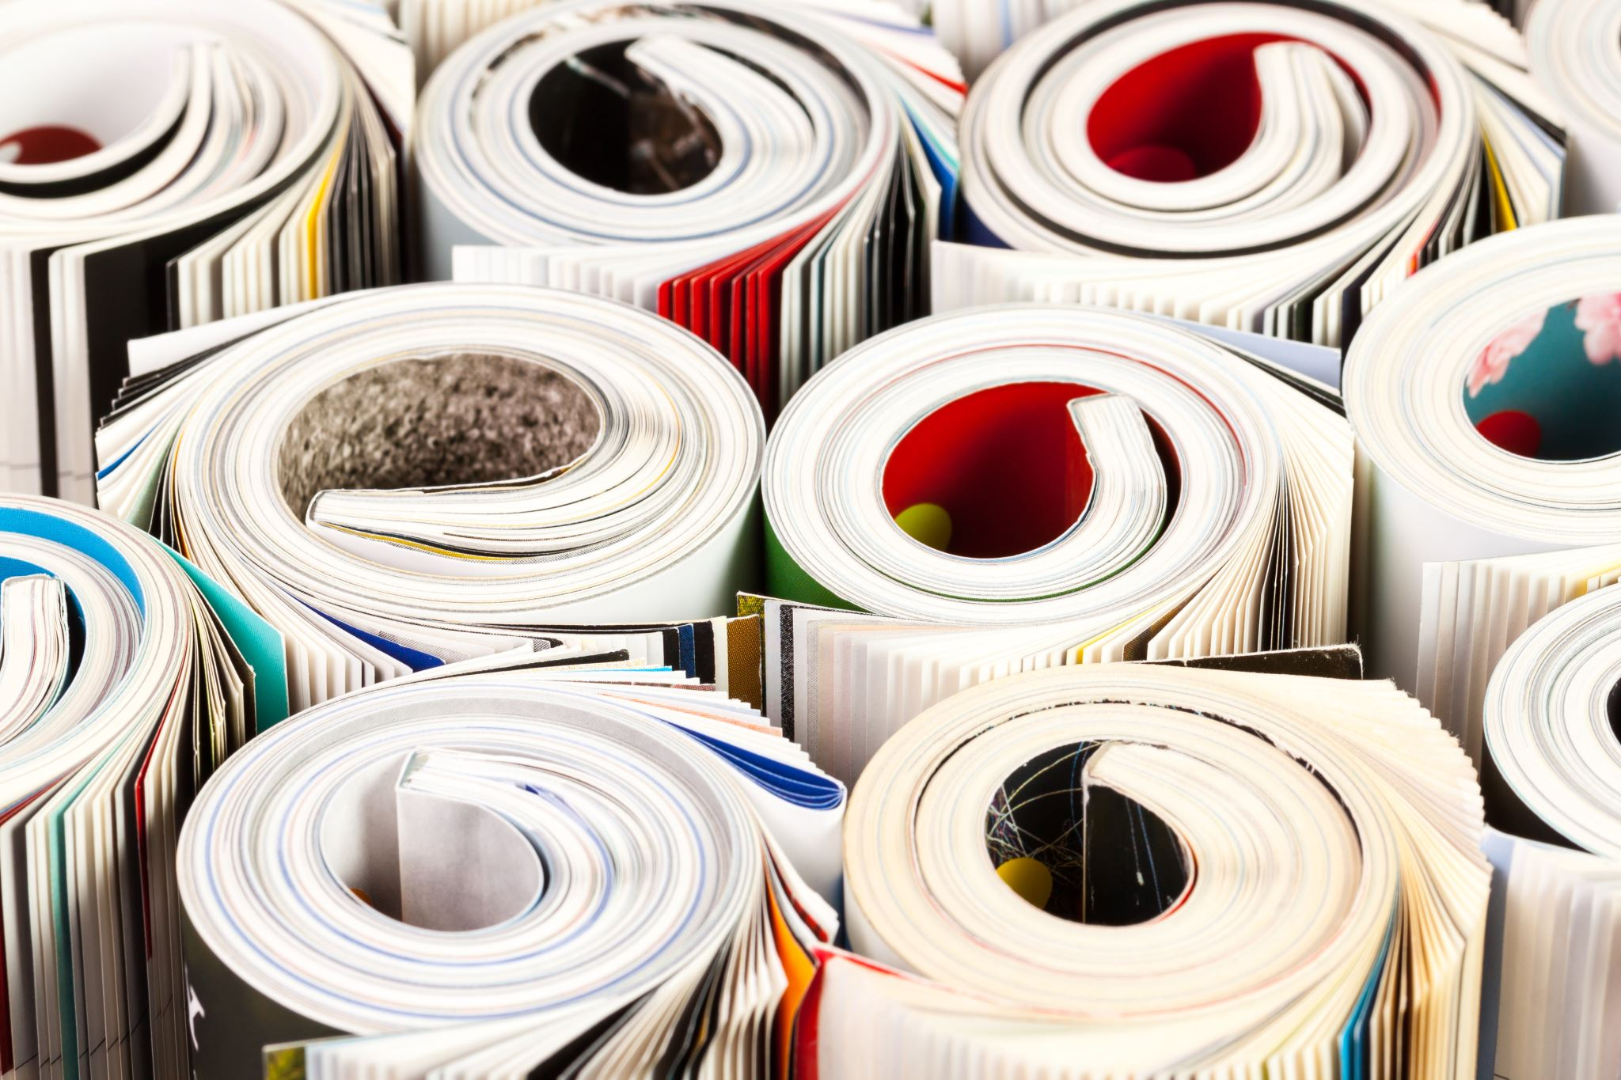
Benefits and Disbenefits - Traditional method
Benefits:
Low Cost: Simple equipment keeps setup costs low.
Easy Labor: Existing workforce can likely adapt to these methods.
Simple Upkeep: Easier to maintain machines with less complexity.
Local Focus: Makes paper products suited for nearby needs.
Disbenefits:
Higher Environmental Impact (Water, Energy, Chemicals): Uses more resources and potentially pollutes water.
Lower Quality: Recycled paper might not be as strong or bright.
Limited Recycling Capabilities: Can only handle certain types of paper waste.
Limited Growth: Not suitable for handling large amounts of paper.

Slide 10
Benefits and Disbenefits – Using Technology
Benefits:
Eco-Friendly: Newer tech can be more efficient, reducing water and energy use.
High-Quality Output: Can produce stronger, brighter recycled paper.
Versatility: Handles a wider range of paper waste for recycling.
Scalable: Adapts to growing waste volumes for future expansion.
Disbenefits:
High Start-Up Cost: Advanced equipment requires a bigger initial investment.
Skilled Labor Needed: May require training workers on new technology.
Complex Operation: Maintenance might be more challenging with intricate machinery.
Limited Market Fit: May not be ideal for communities with very low paper waste.

Slide 11
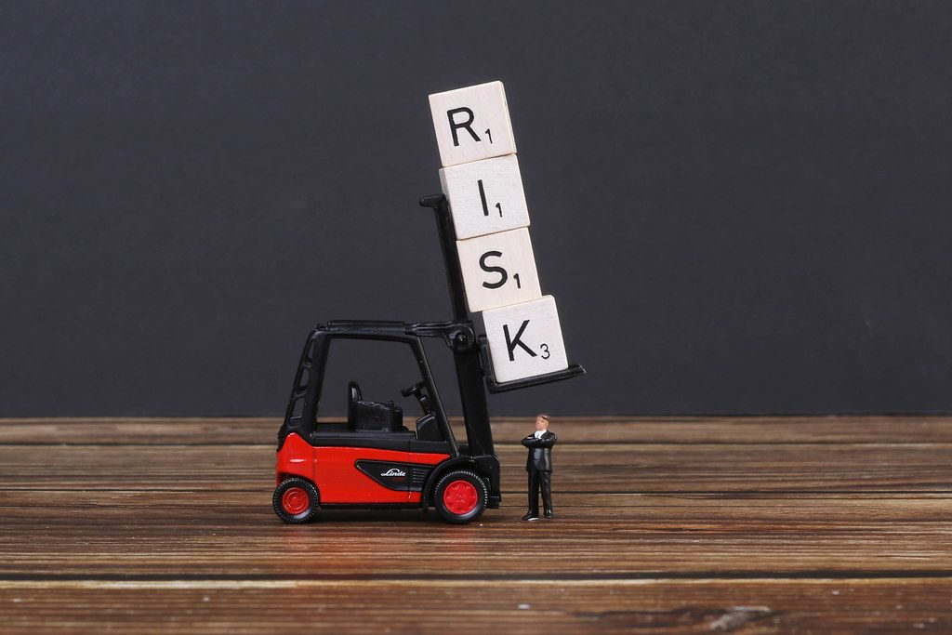
OPTION 1 | OPTION 2
Improper water waste disposal (Water Pollution) | Improper water waste disposal (Water Pollution)
Improper paper waste disposal (Soil Pollution) | Improper paper waste disposal (Soil Pollution)
Inference in Supply Chain | Inference in Supply Chain
Contamination of supply | Contamination of supply
Excess use of water | Excess use of water and energy
Chemical use accidents | Chemical use accidents
Employee absence | Employee absence
Limited capacity | Limited capacity
Institutional acceptance | Institutional acceptance
Public perception | Public perception
Moisture and Mold | Moisture and Mold
Market fluctuation | Market fluctuation
Paper dust combustion | Paper dust combustion
Limited variety | Accidents caused by Machinery
Paper quality | Maintenance cost of Machinery
 | Lack of trained expertise
 | Noise Pollution
 | Air Pollution

Slide 12
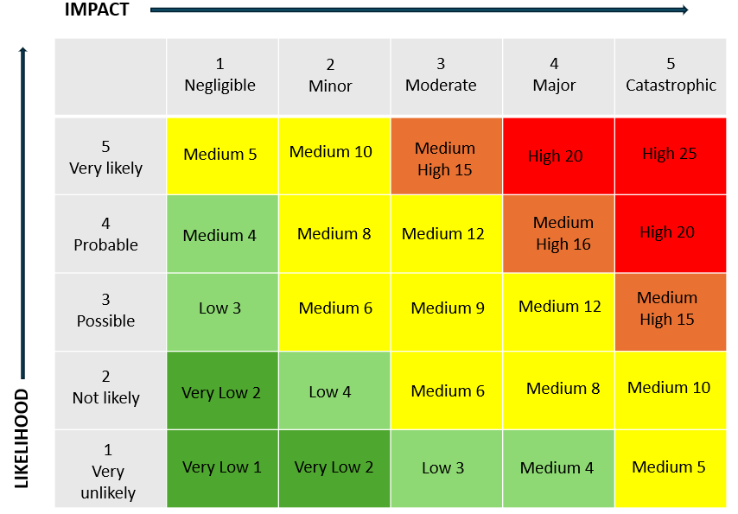
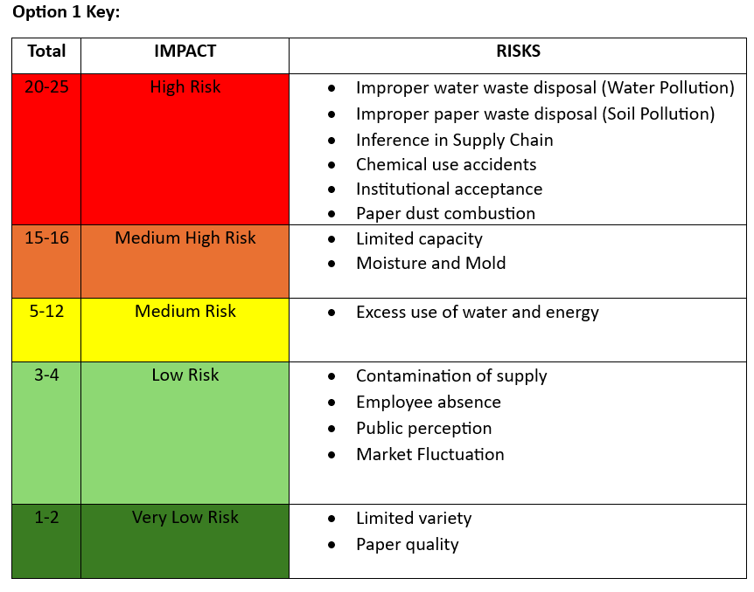
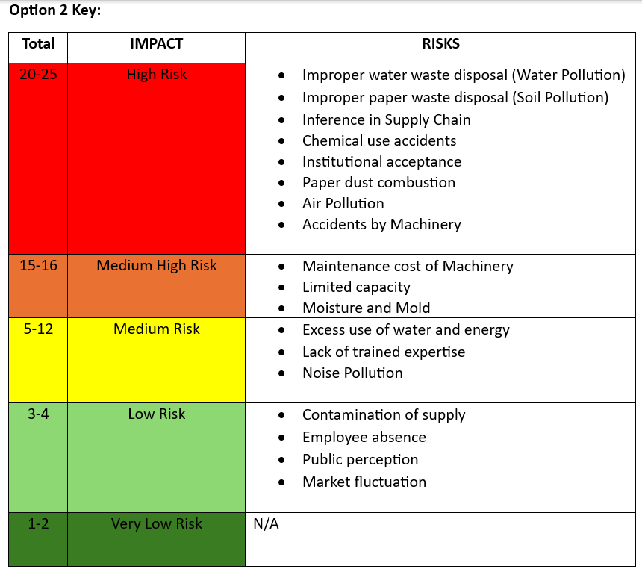
RISK ASSESSMENT AND METIGATION
Careful planning: research, analyze waste, consult experts to design a safe and efficient plant.
Partner with a local recycling company for their knowledge and market access.
Implement safety protocols like training and equipment maintenance.
Engage the community - explain goals and safety measures.
Train staff and students on safe operation, handling materials, and waste disposal.
Enforce use of protective gear (PPE).
Ensure proper ventilation to minimize exposure to hazards.
Develop a plan for managing solid waste and wastewater following regulations.

Slide 13
Cost Calculation:
Find out how much each choice will cost in total, taking into account setup fees, labor, equipment, maintenance, and any other applicable expenditures.
These are your initial investment amounts, for instance, if Option 1 (the traditional technique) costs £2.4 million and Option 2 (the technology-based option) costs £2.6 million.

Slide 14
Payback Period Calculation:
Calculation of Payback Period: The payback period is the amount of time needed for the total cash flows from the project to match the initial investment.
Determine each option's net cash flows. Take the running expenses and deduct these from the money made from recycling paper.
To calculate the payback period, divide the initial investment by the net yearly cash flow.
For instance, the payback period would be £2.4 million / £600,000 = 4 years if Option 1 produced a net cash flow of £600,000 annually.

Slide 15
Average Rate of Return (ARR) Calculation:
The average yearly return on investment is expressed as a percentage, or ARR. By dividing the total net cash flows during the project's duration by the number of years, you can find the average yearly cash flow.
To calculate the ARR, divide the average yearly cash flow by the initial investment and multiply the result by 100.
For instance, the ARR would be (£700,000 / £2.6 million) * 100 = 26.92% if Option 2 had an initial investment of £2.6 million and an average yearly cash flow of £700,000.

Slide 16
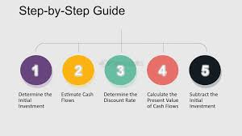
Net Value Calculation:
By taking the time worth of money into account, Net Value—also referred to as Net Present Value or NPV—determines the profitability of the project.
Using a suitable discount rate (often the project's cost of capital or a comparable rate), reduce the net cash flows for each year to their present value.
To find the net value, deduct the original investment from the net cash flow present value.
For instance, the net value would be £3 million - £2.4 million = £600,000 if the discount rate is 10% and the present value of Option 1's net cash flows throughout the project's life is £3 million.

Slide 17

REFERENCE
Waste Watch (2003) Resource management in the education sector, Biffaward Programme on Sustainable Resource Use. report. https://www.sustainabilityexchange.ac.uk/files/education_sector_report.pdf.
Official, T.C. (2023) 'Sustainable Innovations: The Paper Industry’s Positive Impact on the Environment through Waste Paper Recycling.' https://www.linkedin.com/pulse/sustainable-innovations-paper-industrys-positive-pm7kc/.
Thakur, M. (2022) Tamil Nadu paper mill triggering air and water pollution, complaint filed. https://www.planetcustodian.com/tamil-nadu-paper-mill-air-and-water-pollution/26820/
Wilson, A. (2024) Recycling: Is it as good as we think? https://www.boisestate.edu/cobe/blog/2023/07/recycling-is-it-as-good-as-we-think/#:~:text=Recycling%20can%20also%20have%20negative,into%20the%20air%20and%20water.
Health and safety in the recovered paper sector (no date). https://www.hse.gov.uk/waste/recoveredpaper.htm#:~:text=Before%20paper%20can%20be%20recycled,properly%20controlled%2C%20can%20cause%20injury.
Samani, N. (2023) Paper manufacturing: Critical issues and challenges. https://www.deskera.com/blog/paper-manufacturing-critical-issues-and-challenges/.
Pulp and Paper Technology (2022) Process deinking and recycling technologies for pulp and paper. https://www.pulpandpaper-technology.com/articles/deinking-and-recycling-technologies
Business Bliss FZE (2023) Advantages and Disadvantages of Paper Recycling Plants Environmental Sciences Essay. https://www.ukessays.com/essays/environmental-sciences/advantages-and-disadvantages-of-paper-recycling-plants-environmental-sciences-essay.php.

